Slide 1
Machine Learning
Gradient Boosting

Slide 2
Ensemble Technique :
Ensemble technique is a technique which uses multiple weak learners to produce a strong model for regression and classification.
Ensemble methods combine different decision trees to deliver better predictive results, afterward utilizing a single decision tree.
There are techniques given below that are used to perform ensemble decision tree :
Bagging
Boosting
Voting

Slide 3
Bagging: Bagging is used to build multiple model from sample of training dataset. Here the concept is to create a few subsets of data from the training sample, which is chosen randomly with replacement. Each collection of subset data is used to prepare training thus, end up with an ensemble of various models. The average of all the assumptions from numerous trees is used, which is more powerful than a single decision tree
Boosting : Boosting is another ensemble procedure to make a collection of predictors. In other words, we fit consecutive model, usually random samples, and at each step, the objective is to solve net error from the prior model.

Slide 4
Gradient Boosting:
Gradient boosting is an supervised machine learning algorithm used for classification and regression problems.
Gradient boosting is one of the most powerful boosting algorithm for building
Gradient boosting model combines the predictions from multiple model to generate the final predictions. So, every successive model is built on the errors of the previous model. This is how the model in a gradient boosting machine algorithm are built sequentially predictive models.

Slide 5
GBM uses the boosting technique, combining a number of weak learners to form a strong learner
All the weak learners in a gradient boosting machine are decision trees.
Each predictor is trained using the residual error of previous model as labels.

Slide 6
Each tree predicts a label and final prediction is calculated by :
Y(pred) = y1 + (learning rate * r1) + (LR * r2) + (LR * r3) + ………….+ (LT * rN)

Slide 7
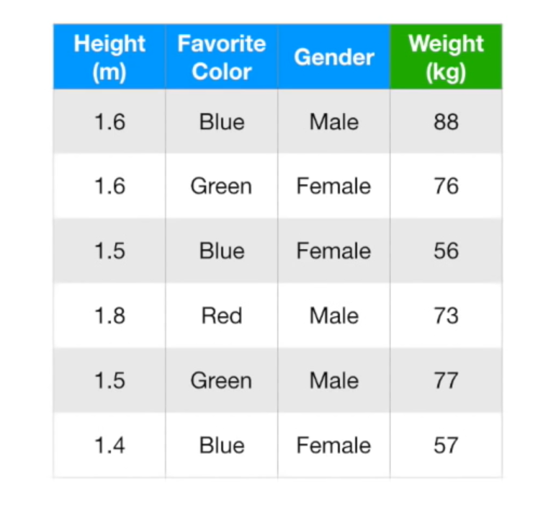
Intuition behind Gradient Boosting :

Slide 8
Step 1: To calculate average of target variable.
(88+76+56+73+77+57)/5 = 71.2
Average Weight
71.2
71.2
71.2
71.2
71.2
71.2

Slide 9
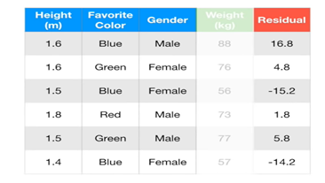
Step 2 : calculate the residuals for each sample. Residual = Actual Value - Predicted Value

Slide 10
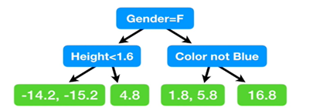
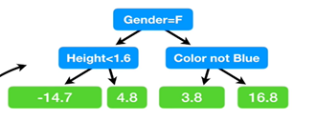
Use decision tree algorithm to train the model considering residual as label . We build a tree with the goal of predicting the Residual

Slide 11
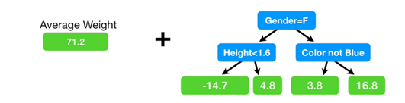
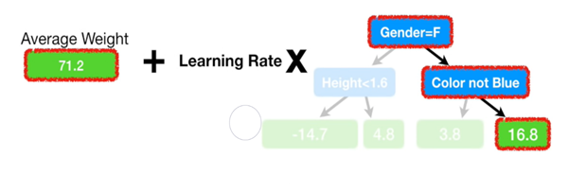
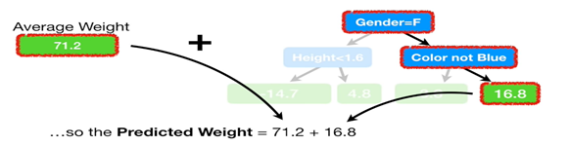
Now we combine the Original leaf and the new tree to make a prediction of an individual’s weight from the Training Data.

Slide 12
Predicted weight for 2nd iteration:
71.2+(0.1*16.8) =72.9
Example for first Record, Residual=Observed Weight- Predicted Weight
= (88-(71.2+(0.1*16.8))
=(88–72.9) where 72.9 is the latest prediction.
= 15.1

Slide 13
New residual
15.1
4.3
-13.7
1.4
5.4
-12.7

